Slide 1
Vision and Language

Slide 2
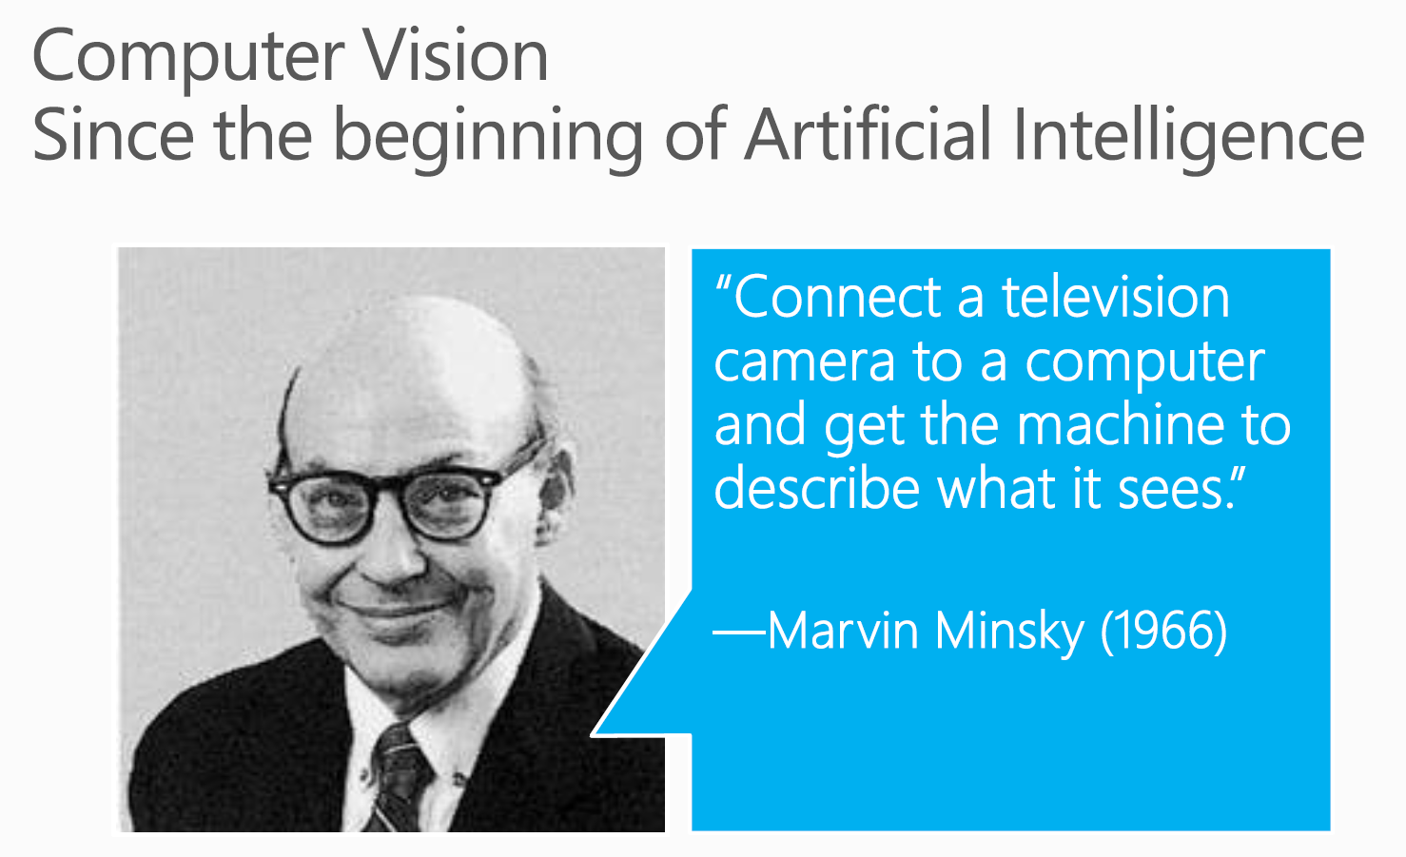

Slide 3
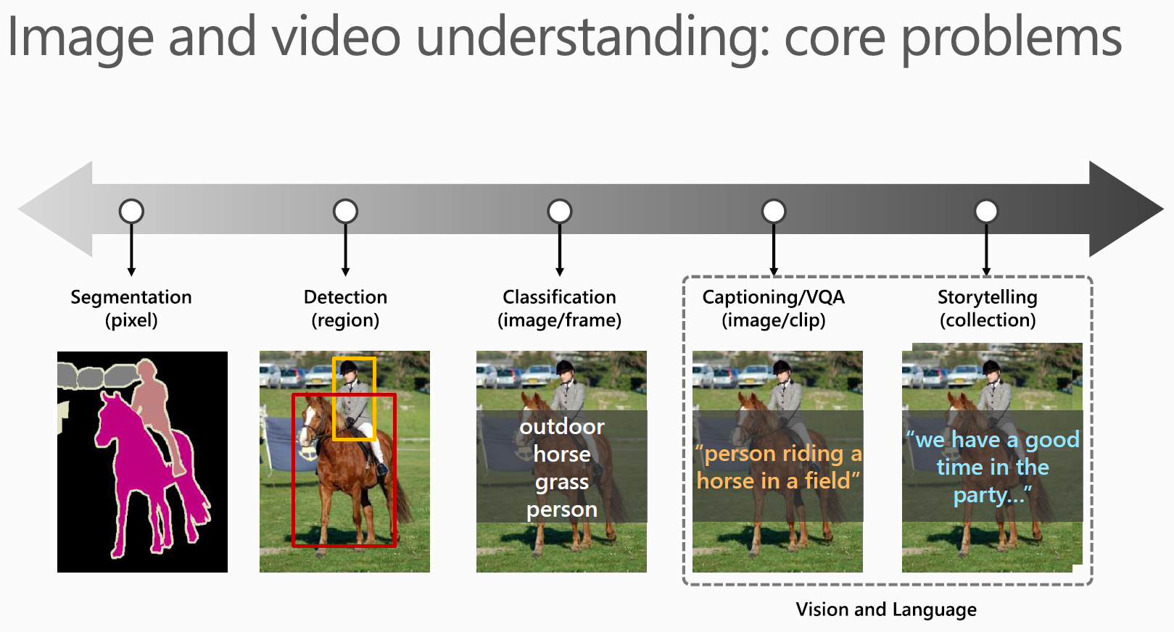

Slide 4
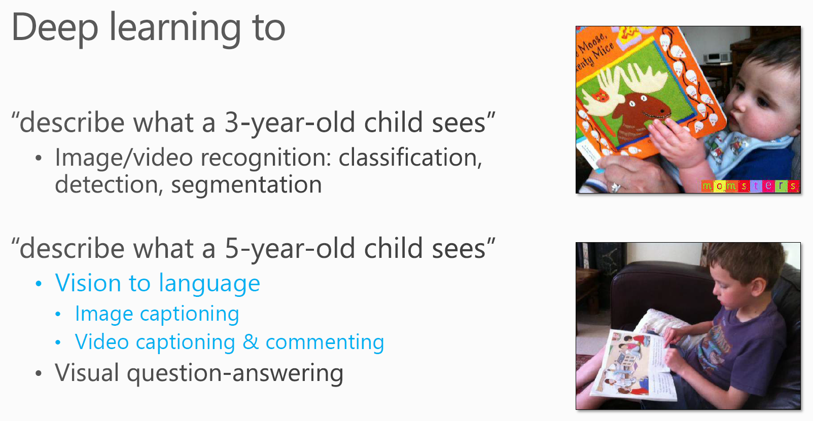

Slide 5
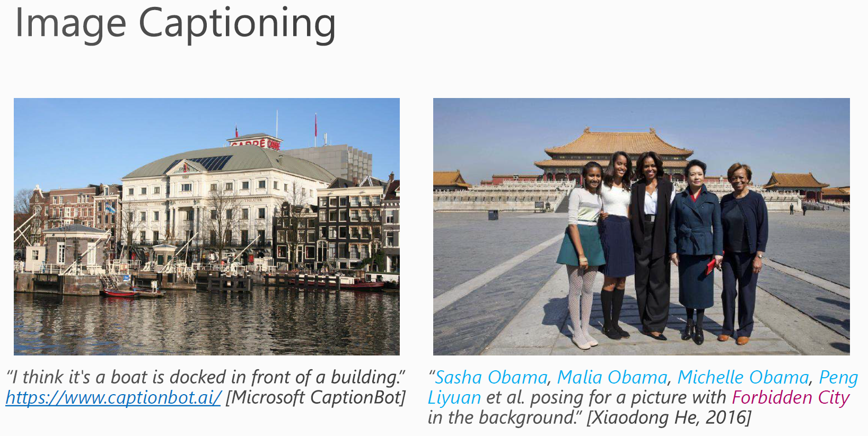

Slide 6
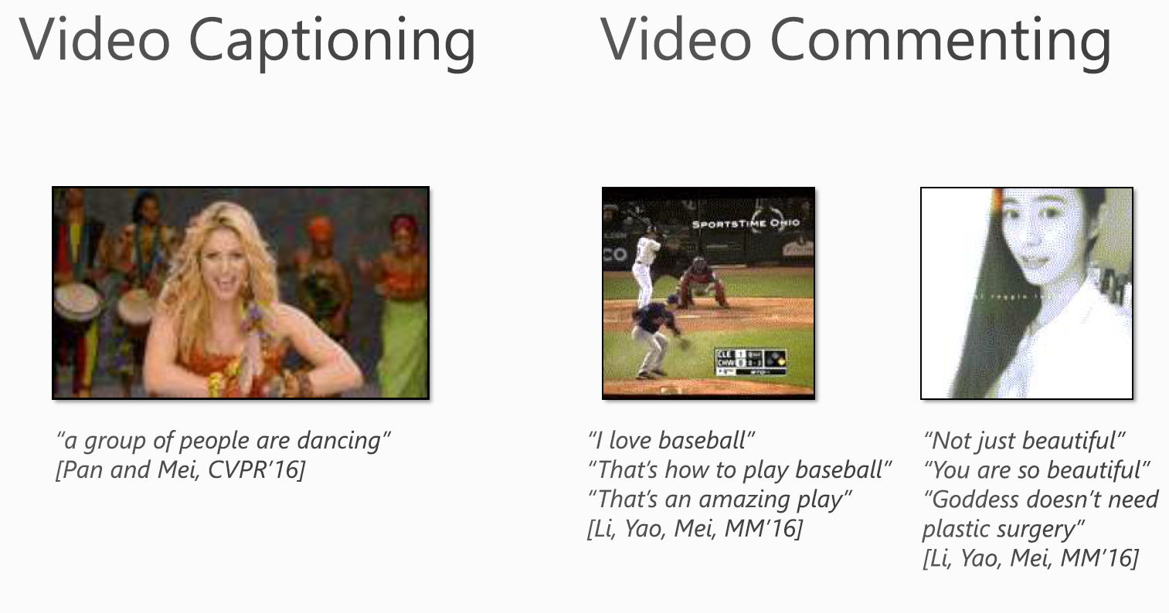

Slide 7
Visual Captioning

Slide 8
What is visual captioning
Automatic generation of natural language sentences that describe the contents of a given video or a given image
Two components:
understanding the visual content — CV
describing it in grammatically correct sentences — NLP
Special issue “Language in Vision” on CVIU2017
Workshops on ICCV2015, CVPR2018, NAACL2018, ICCV2019

Slide 9
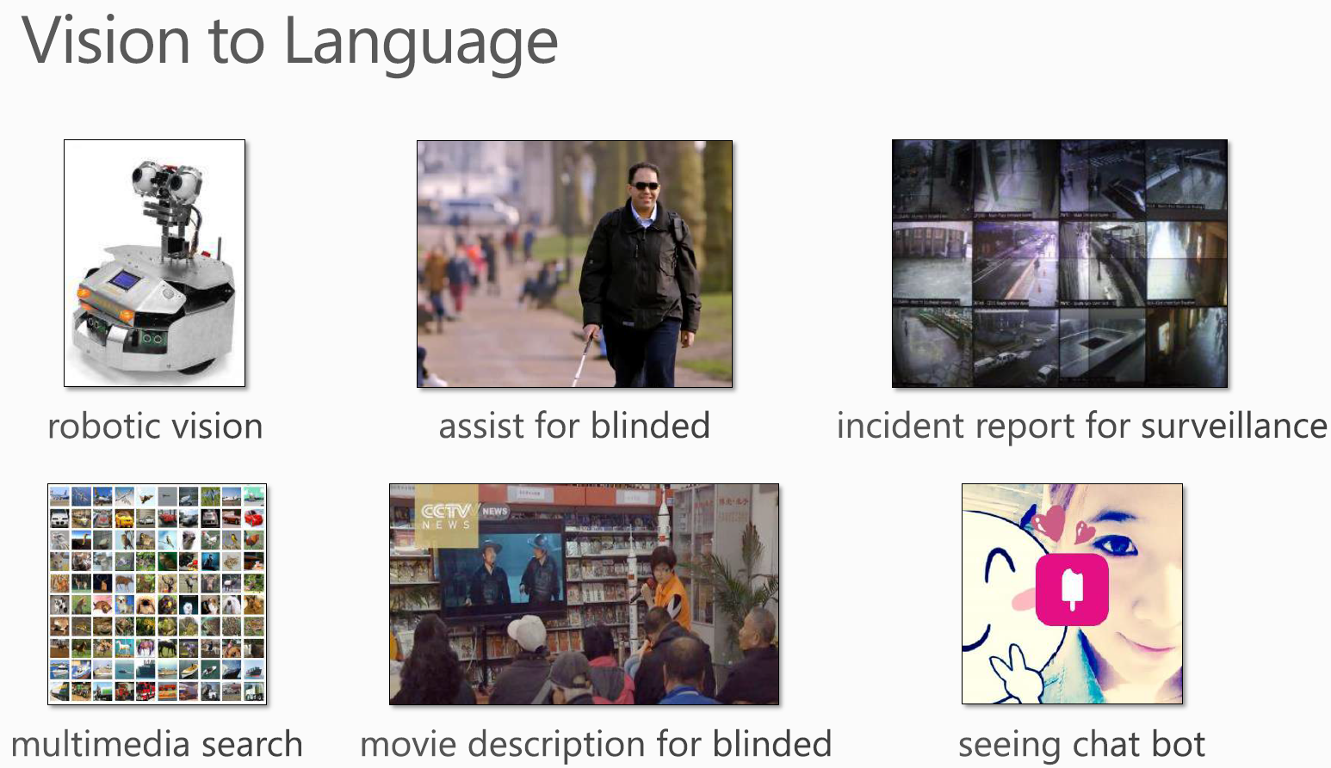

Slide 10
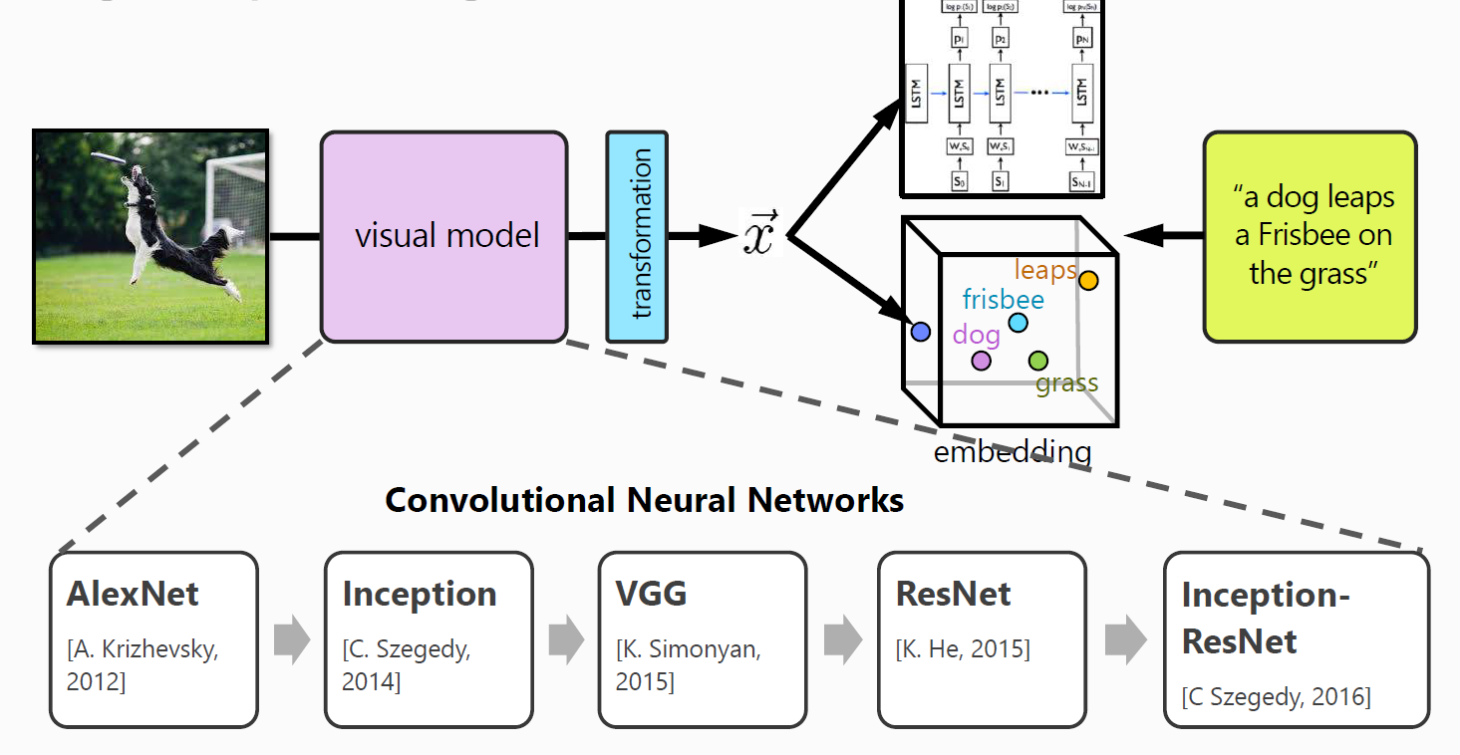
Visual captioning: basic idea

Slide 11
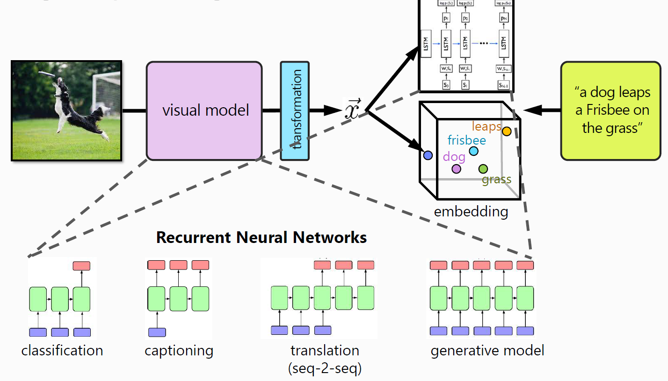
Visual captioning: basic idea

Slide 12
Relation between image and video captioning

Slide 13
Template based methods
First detect entities (objects, actions, scenes) in videos
Then fit them to standard sentence templates
Only effective in very constrained environments (short clips or videos with limited numbers of actions and objects)

Slide 14
SVO (Subject, Verb, Object)
Subject (human) focused
Action and object focused
SVO methods for open domain videos
[Das et al. CVPR]
Hybrid method, entities detection,
Concept detection,
High relevance
[Guadarrama et al. ICCV]
Open domain videos,
Language driven,
Zero-shot verb recognition.
[Hakeem et al. AAAI]
Multiple persons, CaseE, causal relation
[Khan et al. ICCVW]
Human-object interaction, 5 action, emotions
[Hackman et al. ECCV]
Human-human interaction, 48 actions.
2002 2004 2008 2011 2012 2013 2014
[Kojima et al. IJCV]
One person-one action
[Lee et al. CVPRW]
Visual content annotations,
> 400 objects
[Barbu et al. arXiv]
Object tracking,
70 object classes,
48 actions,
118 words vocab
[Krishnamoorthy et al. AAAI]
Open domain videos,
20 PASCAL objects,
Web-text corpora
[Thomoason et al. COLING]
Open domain videos,
Added 12 scenes,
Out of domain text corpora

Slide 15
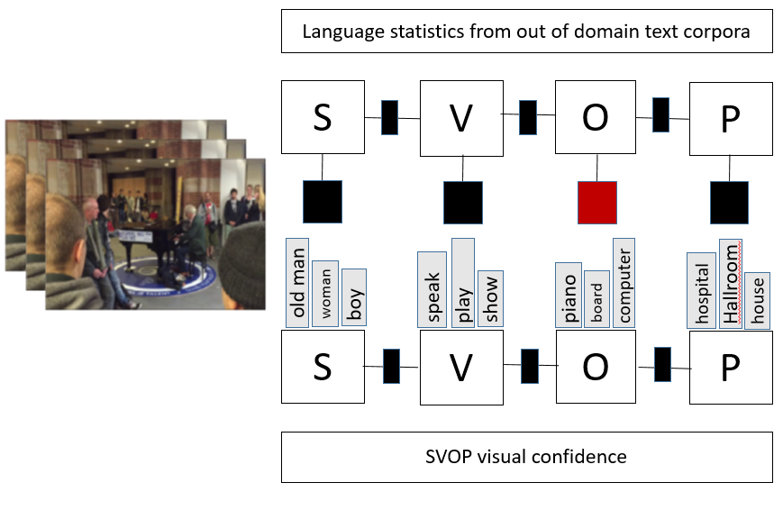
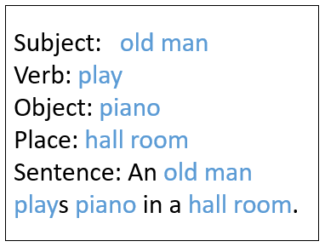
SVOP (Subject, Verb, Object, Place)

Slide 16
Deep learning models
Visual feature extraction — visual encoding stage
Sentence generation — decoding stage

Slide 17
CNN+RNN
Convolution architectures for visual encoding
Recurrent structures for decoding
2D-CNN+RNN
Venugopalan et al., Translating Videos to Natural Language Using Deep Recurrent Neural Networks, HLT-NAACL, 2015.
3D-CNN+LSTM
Yao et al., Describing videos by exploiting temporal structure, ICCV, 2015.
Song et al., Hierarchical LSTM with adjusted temporal attention for video captioning, IJCAI, 2017.

Slide 18
3D-CNN+RNN
a spatial temporal 3D-CNN representation
— capture short temporal dynamics (local structure)
a temporal attention mechanism
— select the most relevant temporal segments (global structure)
Li Yao, Atousa Torabi, Kyunghyun Cho, Nicolas Ballas, Christopher J. Pal, Hugo Larochelle, and Aaron C. Courville. Describing videos by exploiting temporal structure. In ICCV, pages 4507–4515, 2015.

Slide 19
RNN+RNN (sequence-to-sequence)
Recurrent structures for both encoding and decoding
Venugopalan et al., Sequence to Sequence - Video to Text, ICCV, 2015.
Donahue et al., Long-term recurrent convolutional networks for visual recognition and description, CVPR, 2015.
Baraldi et al., Hierarchical Boundary-Aware Neural Encoder for Video Captioning, CVPR, 2017.
Wang et al., Reconstruction network for video captioning, CVPR, 2018.

Slide 20
RNN-RNN
A stacked LSTM first encodes the frames one by one, then generates sentence word by word
Handle variable number of input frames
Learn temporal structure of the video
Subhashini Venugopalan, Marcus Rohrbach, Jeffrey Donahue, Raymond J. Mooney, Trevor Darrell, Kate Saenko, Sequence to Sequence - Video to Text. ICCV, 2015.

Slide 21
Attention
Learn which part of the video to focus on
Li et al., MAM-RNN: multi-level attention model based RNN for video captioning, IJCAI, 2017.
Gao et al., Video captioning with attention-based LSTM and
semantic consistency, TMM, 2017.
Wang et al., Spotting and aggregating salient regions for video
captioning, ACM MM, 2018.
Chen et al., Motion guided spatial attention for video captioning,
AAAI, 2019.

Slide 22
Attention
integrate attention mechanism with LSTM to capture salient structures of video
use the dynamic weighted sum of local 2D CNN representations
Lianli Gao, Zhao Guo, Hanwang Zhang, Xing Xu, and Heng Tao Shen. Video captioning with attention-based LSTM and semantic consistency. IEEE Trans. Multimedia, 19(9):2045–2055, 2017.

Slide 23
Semantic attribute
Exploit the visual semantics in addition to visual features
Fang et al., From captions to visual concepts and back, CVPR, 2015.
Ramanishka et al., Multimodal video description, ACM MM, 2016.
You et al., Image captioning with semantic attention, CVPR,2016.
Pan et al., Video captioning with transferred semantic attributes,
CVPR, 2017.

Slide 24
Semantic attribute
learns to selectively attend to semantic concept proposals
fuse semantic concept into hidden states and outputs of recurrent neural networks
Quanzeng You, Hailin Jin, Zhaowen Wang, Chen Fang, and Jiebo Luo. Image captioning with semantic attention. CVPR, 2016.

Slide 25
Deep reinforcement learning
Optimize sequence generation model using reinforcement learning with reward
Rennie et al., Self-critical sequence training for image captioning, CVPR, 2017.
Wang et al., Video captioning via hierarchical reinforcement
learning, CVPR, 2018.
Chen et al., Less Is More: Picking Informative Frames for Video
Captioning, ECCV, 2018.

Slide 26
Dataset

Slide 27
Dataset

Slide 28
Evaluation metrics
Automatic evaluations
BLEU (Bilingual Evaluation Understudy)
ROUGE (Recall Oriented Understudy for Gisting Evaluation)
METEOR (Metric for Evaluation of Translation with Explicit Ordering)
CIDEr (Consensus based Image Description Evaluation)
SPICE (Semantic Propositional Image Captioning Evaluation)
Human Evaluations
Relevance
Grammar Correctness

Slide 29
Limitations of evaluation metrics

Slide 30
Advanced work on visual captioning

Slide 31
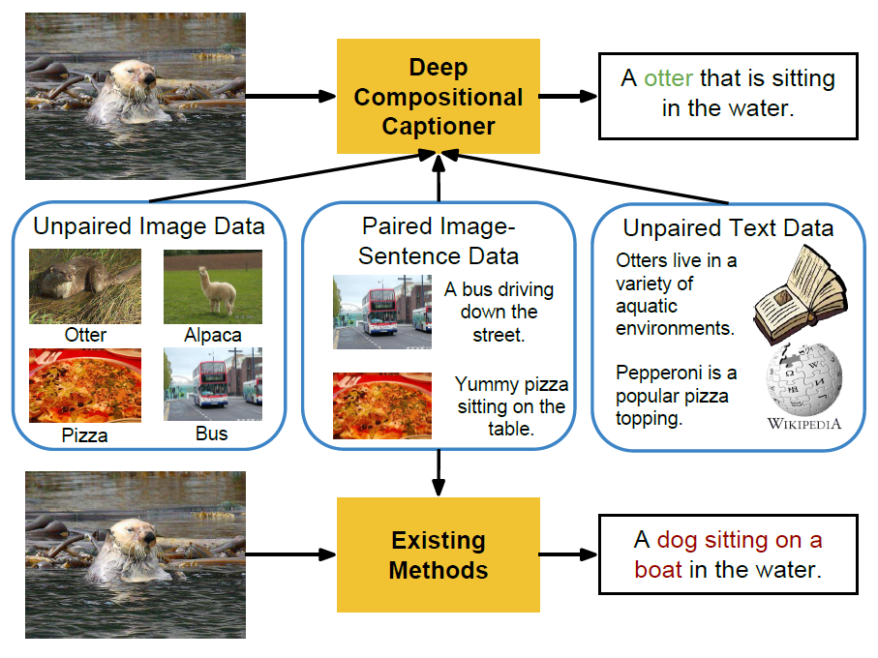
Deep Compositional Captioning: Describing Novel Object Categories without Paired Training Data
address the task of generating descriptions of novel objects which are not present in paired image-sentence datasets

Slide 32
Deep Compositional Captioning: Describing Novel Object Categories without Paired Training Data
A separate lexical classifier and language model, which can each be trained independently on unpaired image data and unpaired text data.
the lexical classifier and language model can be combined into a deep caption model which is trained jointly on paired image-sentence data
the multimodal layer where knowledge from known objects in paired image-sentence datasets can be transferred to new objects only seen in unpaired datasets.

Slide 33
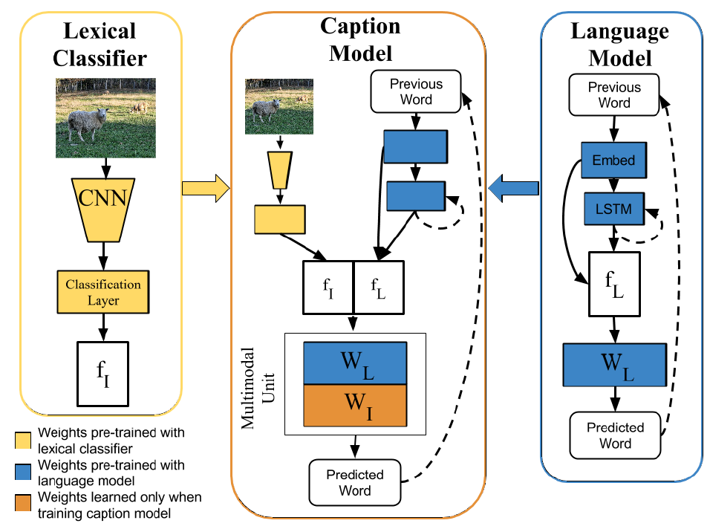
Deep Compositional Captioning: Describing Novel Object Categories without Paired Training Data

Slide 34
Unsupervised Image Captioning
Most of the existing models depend heavily on paired image-sentence datasets, which are very expensive to acquire.
Our proposed model merely requires an image set, a sentence corpus, and an existing visual concept detector.
The sentence corpus is used to teach the captioning model how to generate plausible sentences.
The knowledge in the visual concept detector is distilled into the captioning model to guide the model to recognize the visual concepts in an image.
The image and caption are projected into a common latent space so that they can be used to reconstruct each other.

Slide 35
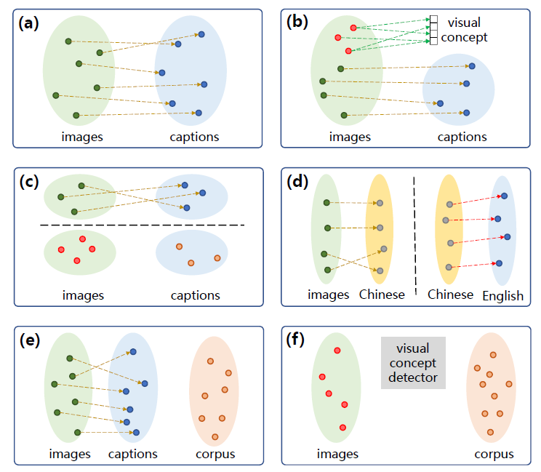
Unsupervised Image Captioning

Slide 36
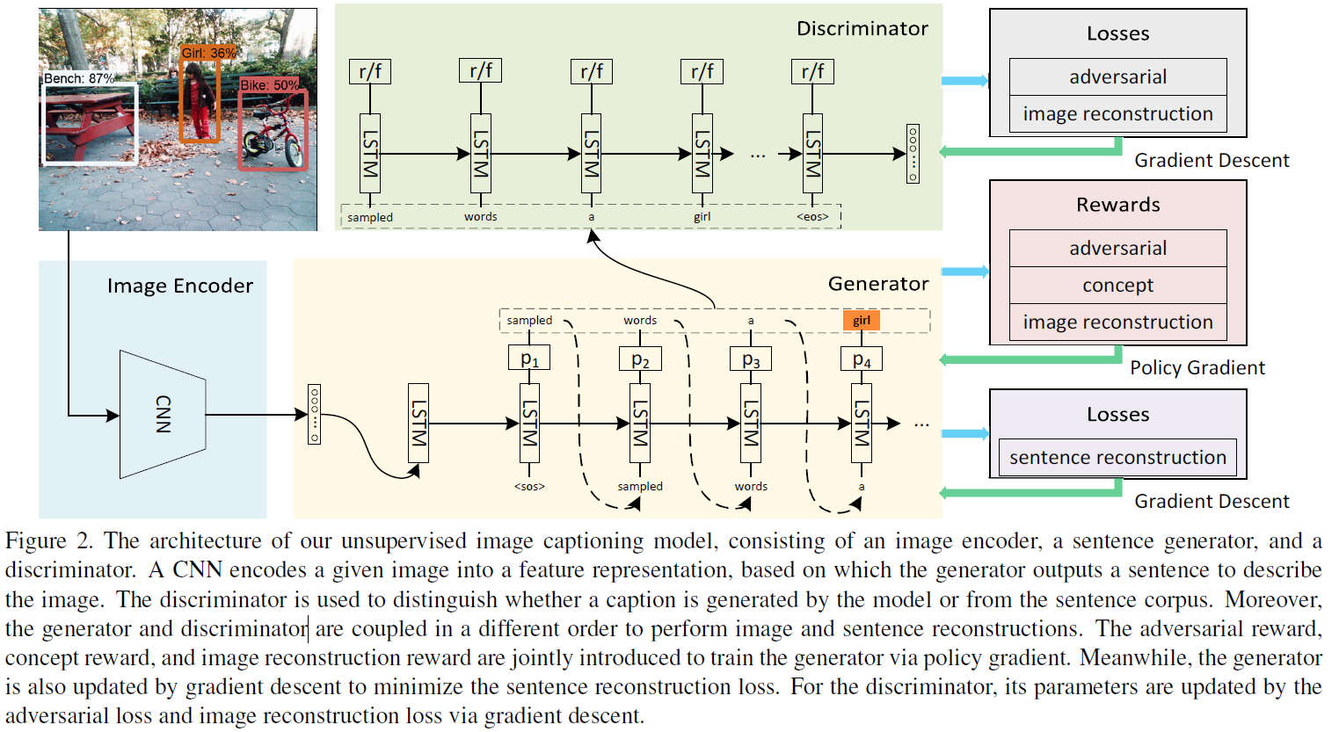
Unsupervised Image Captioning

Slide 37
Informative Image Captioning with External Sources of Information
Current captioning models are usually trained to generate captions that only contain common object names, thus falling short on an important “informativeness” dimension
A mechanism for integrating image information together with fine-grained labels (assumed to be generated by some upstream models) into a caption that describes the image in a fluent and informative manner
A multimodal, multi-encoder model based on Transformer that ingests both image features and multiple sources of entity labels

Slide 38
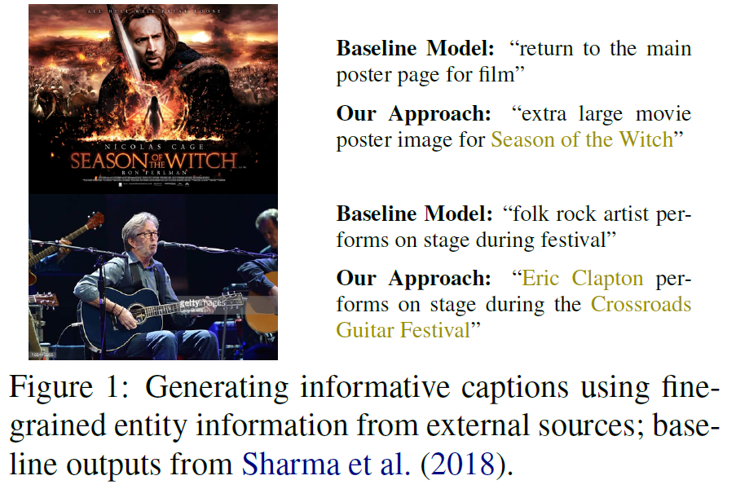
Informative Image Captioning with External Sources of Information

Slide 39
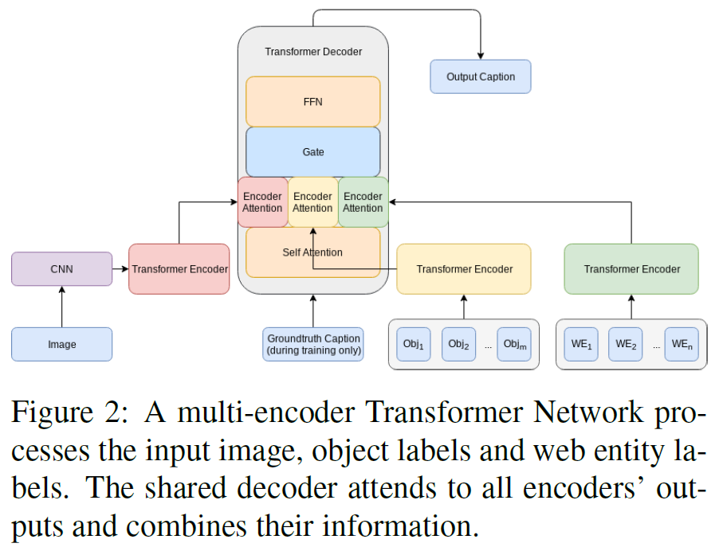
Informative Image Captioning with External Sources of Information

Slide 40
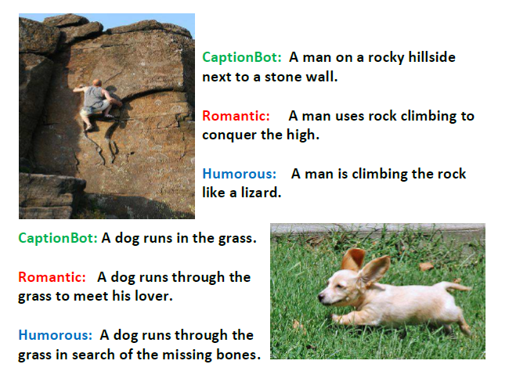
StyleNet: Generating Attractive Visual Captions with Styles
A novel framework named StyleNet to address the task of generating attractive captions for images and videos with different styles

Slide 41
StyleNet: Generating Attractive Visual Captions with Styles
A novel model component, named factored LSTM, which automatically distills the style factors in the monolingual text corpus
Explicitly control the style in the caption generation process so as to produce attractive visual captions with the desired style
Two sets of data: 1) factual image/video-caption paired data, and 2) stylized monolingual text data (e.g., romantic and humorous sentences).

Slide 42
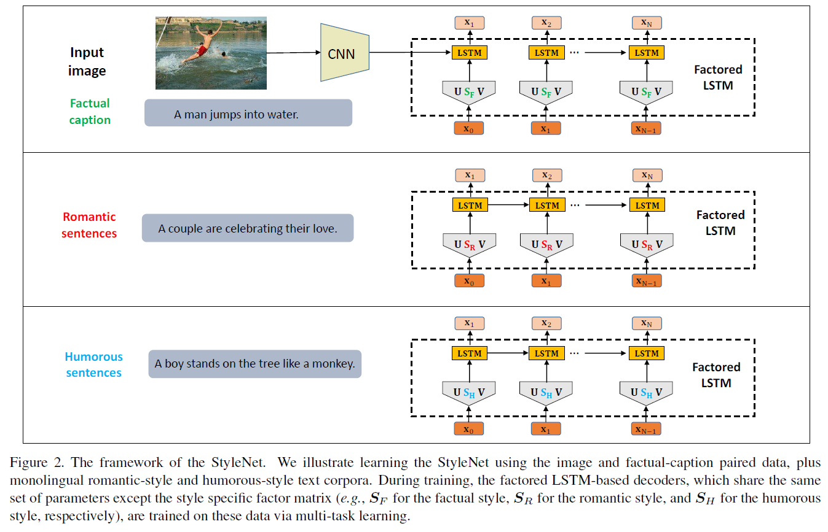
StyleNet: Generating Attractive Visual Captions with Styles

Slide 43
Our work— ICCV2019
Joint Syntax Representation Learning and
Visual Cue Translation for Video Captioning
Jingyi Hou¹, Xinxiao Wu¹, Wentian Zhao¹, Jiebo Luo², and Yunde Jia¹
¹Beijing Lab. of Intelligent Information Technology, Beijing Institute of Technology
²Department of Computer Science, University of Rochester

Slide 44
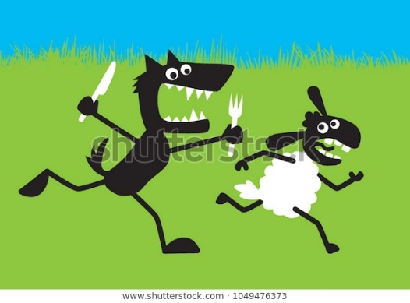
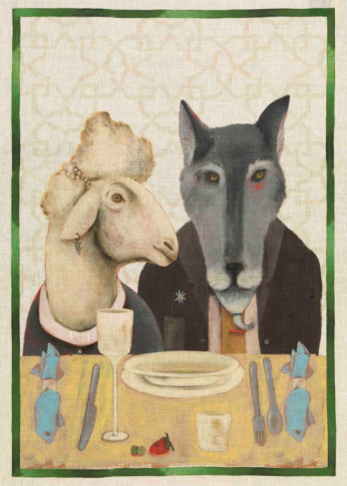
Motivation
“Syntax structure” is essential for a sentence to interpret the video.
Semantics: wolf, eat, sheep
A wolf is eating a sheep.
A wolf and a sheep are eating.
DT->NN->BES->VBG->DT->NN
DT->NN->CC->DT->NN->BES->VBG
The captions differ in meanings with different syntactic structures
Notes:
这个例子是用来说明“Synatax structure”的重要作用的。当只知道语义元素，而不知句法结构时，可能会得到两种表意完全不同的描述。
例如，句子 “A wolf is eating a sheep”和“A wolf and a sheep are eating”具有相同的语义元素，但是却具有不同的含义，以及不同的句子结构。
鉴于句法结构对于文本描述的重要性，本文着重研究如何通过视频来挖掘句法结构信息，并以此提高captioning的性能。
For example, the sentences of “A wolf is eating a sheep” and “A wolf and a sheep are eating” have similar semantic primitives, but differ in their meanings with different syntactic structures.

Slide 45
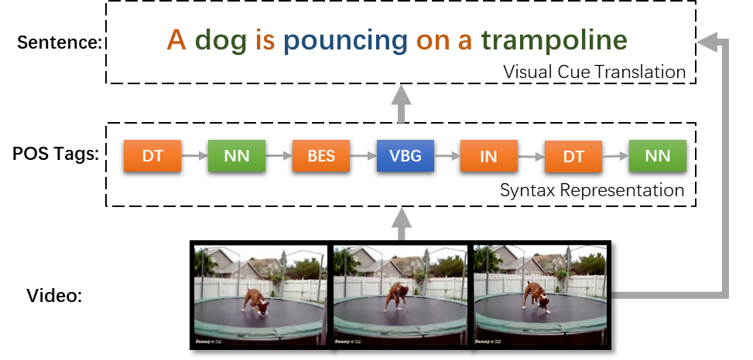
Overview
Jointly learning two subtasks
Syntax representation learning part-of-speech (POS) Tagging
Visual cue translation Mixture Model
Notes:
在自然语言中，表达句法结构信息和语义信息十分关键。
基于此，我们的模型通过联合学习挖掘句法表达和视觉线索翻译来生成视觉描述：首先通过视频词类标注（也就是POS Tagging）发掘句法结构信息，然后根据词类标签来表达语义信息从而生成视频描述。
在生成描述这部分，我们提出了一个mixtrue model，利用词类(pos)指导，来处理因类别数据不平衡引起的模型偏差，稍后会详细介绍。
we propose a novel video captioning approach that takes into account both visual perception and
syntax representation learning to generate accurate sentences of videos.
For an input video, we first learn its syntax representation via video POS tagging and then translate the visual cues to words given the inferred POS via a mixture model.

Slide 46
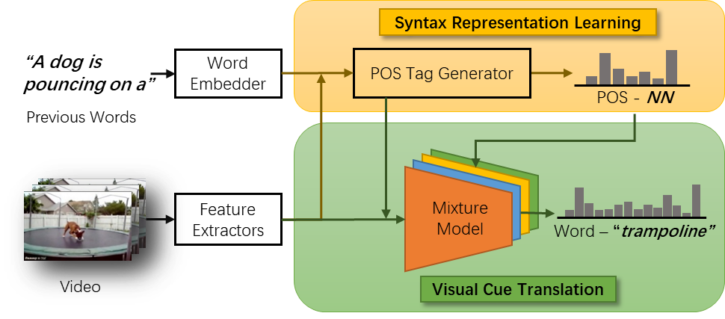
Architecture
Notes:
具体地，我们提出一个端到端可训练的网络来联合学习句法结构和视觉线索从而生成视频的文本描述。
网络可分为两个模块：一个模块由基于序列的模型构成，将视频标注为词类序列；另一个模块是一个多个分类器组成的混合模型，根据词性将视觉线索翻译为单词。
Our method contains two key modules: syntax representation learning and visual cue translation. The syntax representation learning module takes extracted video features and embedded previous words as
input and outputs POS sequences using a based model.
The visual cue translation module is implemented by a mixture of multiple components explicitly conditioned on the
inferred POS tags, where each component takes specific visual cue features as input.
The network is end-to-end trainable that jointly models the video POS tagging and visual cue translation for video captioning.

Slide 47
Formulation
Joint probability
Maximize the likelihood function
Input Video:
POS sequence:
Caption：
video POS tagging
visual cue translation
Notes:
我们对两个任务进行联合建模，每个词类和单词的概率以输入视频为条件，除此之外，当前词类标签概率以前面的单词 为条件，当前的单词概率 以其词类标签 为条件。整体的优化问题即可转化为联合优化公式中的两项。这两项分别对应两个子任务，即视频词类标注和视觉线索翻译。
We build a probabilistic directed acyclic graph to learn the two subtasks jointly.
The generation of the POS tag is conditioned on the input video and all the previous words to determine its contextual location in a sentence.
The generation of the word is conditioned on its corresponding POS tag as well as the video.
To learn the optimal parameters , we maximize the likelihood function over the training data.
Accordingly, the overall optimization problem can be regarded as jointly optimizing two terms in the equation, corresponding to video POS tagging and visual cue translation, respectively.

Slide 48
Syntax representation learning
Video POS tagging: sequence to sequence (S2S) model
Constraint
diversify the POS in each generated sentence
encourage each POS tag to appear in a sentence at least once
t₁
t₂
t_{i}
···
s₀
s₁
s_{i-1}
v
Notes:
Postag是个rnn模型，Constraint的一句话描述
The loss function for video POS tagging.
Generally speaking, a complete sentence should be constituted of various kinds of grammatical elements.
Therefore, we introduce a simple yet effective constraint term to diversify the parts of speech in each generated sentence to guarantee the completeness of captions. The constraint term encourages each POS to appear in the generated sentence at least once by using L2 normalization.
这是视频词类标注的损失函数，除此之外为了保证每个句子中词类的多样性，我们提出一个约束项鼓励每个词类标签在句子中至少出现一次，由简单的l2正则化实现

Slide 49
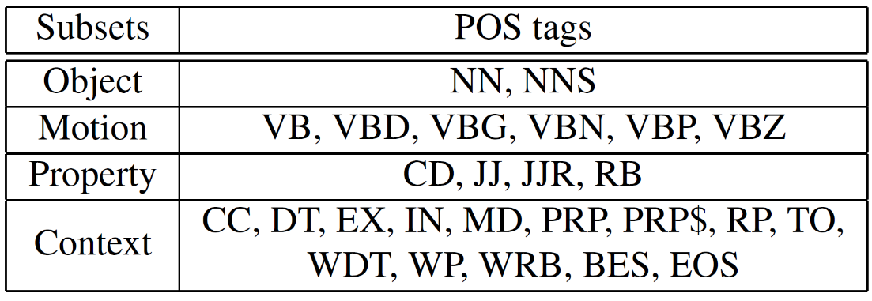
Visual Cue Translation
Visual cue translation
conditional probabilities of words
mixture component
Mixture model
conditional probabilities of POS tags
Pros of the mixture model:
Alleviate the word bias problem
Alleviate the softmax bottleneck problem
Notes:
视觉线索翻译的损失函数是第一个式子
由于单一的分类器很难学习到如此广阔的包含各种单词（运动类、物体类等）词汇空间的分布，我们提出使用混合模型来生成类别分布，其中每个混合成分都是一个特定的分类器，这些分类器可分别看作专家（expert），即擅长某些特定大类别（如运动类、物体类）的分类。这些混合成分的先验概率取决于对应的词类。例如，如果词类是动词，则运动相关的分类器输出概率分布会得到较大的权重。另外，利用词类指导，我们的混合模型可以处理因类别数据不平衡引起的模型偏差。可以体现在反向求导过程中
我们的模型可以解决不平衡类别的问题，因为英语单词词频差异非常大，因此类别不均衡。幸好单词可以根据POS分为两种不同的集合，一种是开集，有实际语义含义，比如动词名词，另一种是闭集，一般没有具体语义，作为上下文的连接出现，例如连词介词等。开集的单词数量很多，但是词频较小，闭集的单词数量有限，但词频较大，我们根据这种特性，将单词显式地分为四种集合，物体、运动、属性、上下文，这四种集合也对应不同的视觉线索，使用对应的分类器来进行分类，总体数量少的但词频大的集合权重会变小，这样在反向求导时的更新力度会变小。
另外，在分类过程中， 因为单词数量过多，会引发softmax bottleneck问题，即线性函数后跟一个softmax激活函数不足以表达如此多种类的信息，而我们的混合模型因为是一个高度非线性的模型，避免了该bottleneck，从而使caption结果更好
Our model can address the imbalanced classes problem by dividing the words into four subsets, as inferred from the back propagation process.
Softmax bottleneck is a case that a single softmax function is used at the top of the network to obtain the probability distribution over word categories. When the number of output word categories is much larger than the representation dimension, the softmax layer will limit representation power.

Slide 50
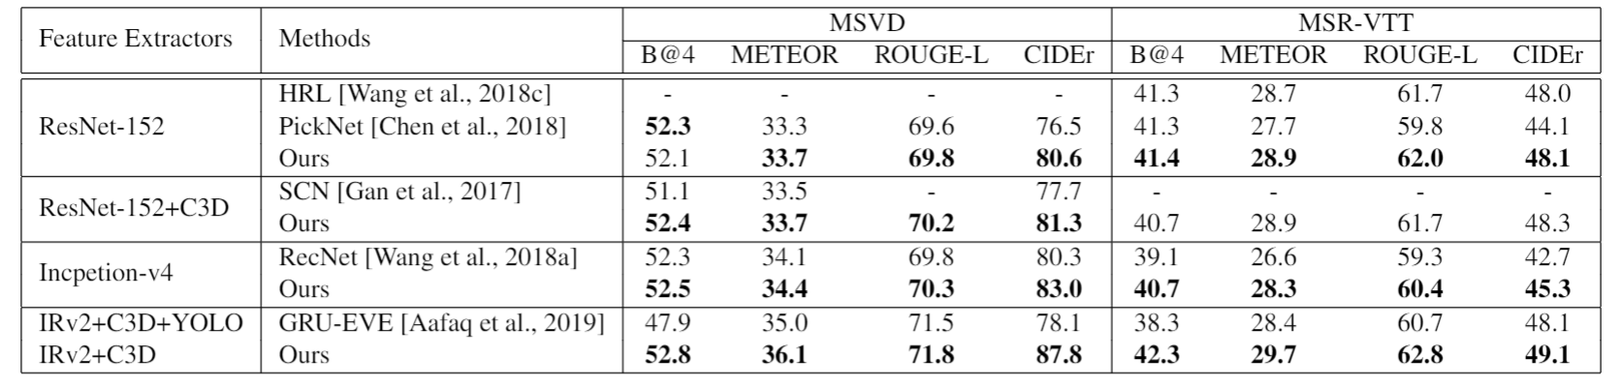
Results
Comparison with recent methods using the same features
Table 1. Performance evaluation of our method using the same features with the recent state-of-the-art methods on the MSVD and MSR- VTT datasets.
Notes:
Performance evaluation of our method using the same features with the recent state-of-the-art methods on the MSVD and MSR- VTT datasets.
这是我们方法在MSVD和MSR-VTT数据库上与其它方法的比较结果。
For fair comparison, the same features with these methods are used as the input of our method.
为了进行公平的比较，我们使用了与这些方法相同的输入特征。
In is evident that our method achieves satisfactory performances when compared with other methods using the same features.
与这些方法相比，我们的方法取得了令人满意的性能。
Note that in comparison with GRU-EVE [1], for computation simplicity, we do not use the YOLO model to detect objects for extracting better representations and our method still achieves significantly better results than GRU-EVE. This substantially validates the superiority of our method on simultaneously exploring syntatic structure of sentences and perceiving semantic primitives for video captioning.
值得注意的是与GRU-EVE [1]的比较，为了计算简便，我们的方法并没有使用YOLO模型来检测物体以提取更好的特征，即使这样，我们仍取得了比GRU-EVE [1]更好的结果。这表明了我们的方法对学习语法结构和语义信息进行联合学习的有效性。

Slide 51
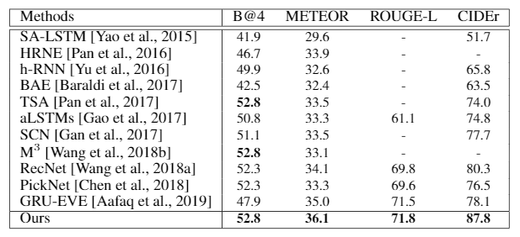
Results
Comparison with SOTA on the MSVD dataset
Table 2. Comparison with the state-of-the-art methods on the MSVD dataset.
Notes:
Moreover, we provide the video captioning results of other state-of-the-art methods for comprehensive comparisons on the MSVD and MSR-VTT datasets.
我们也提供了MSVD和MSR-VTT数据库上的视频captioning的比较结果。
It is obvious that our method consistently performs better than the state-of-the-art methods on both MSVD and MSR-VTT datasets for most evaluation metrics.
在两个数据库上，多个评价准则下，我们的方法都取得了更加优越的性能。
improvement of our method under B@4 is not as remarkable as other evaluation metrics. The probable reason is that our method aims at learning the syntactic structure representation to generate sentences and B@4 is a metric based on lexical rather than syntactic matching [14].
在B@4准则下，我们的方法性能提升不如其它准则下提升得多，主要原因是我们的方法注重语法结果学习，而B@4是一个更注重词法匹配的准则。
This phenomenon that integrating syntactic information often fail to improve the BLEU score is also found and explained in the previous work [5].
融合语法信息后使得B@4指标下降的例子在之前的研究中也有研究者提及。

Slide 52
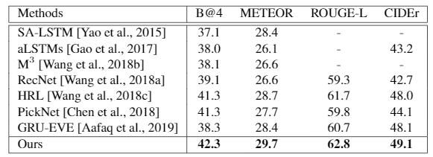
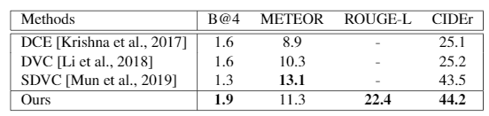
Results
Comparison with SOTA on the MSR-VTT and ActivityNet dataset
Table 3. Comparison with the state-of-the-art methods on the MSR-VTT dataset.
Table 4. Comparison with the state-of-the-art methods on the ActivityNet dataset.
Notes:
We also conduct experiments on the ActivityNet dense captioning dataset. Note that we just use the same features with DCE (Krishna 2017), without further processing the segments in the same video to exploit their contextual information.
注意在activitynet上我们只是使用了和DCE一样的上下文特征，没有像其他方法一样进一步挖掘同一视频中的不同段之间的上下文信息来提高结果。
it is obvious that our method generally outperforms the state-of-the-art methods on a more challenging dataset.
在这个更具挑战性的数据库上，我们的方法也取得了不错的效果。
(公平起见，我们只使用了和对比方法一样的frame level的c3d特征，local feature是temporal attention得到的，rgb feature是mean pooling的，motion feature是加了一个lstm得到的)

Slide 53
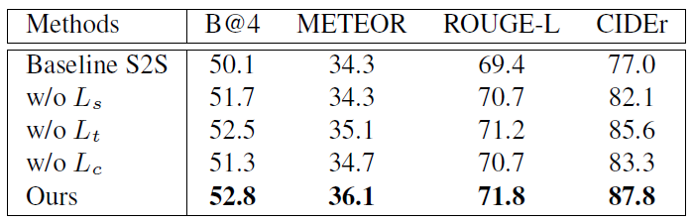
Results
Ablation study
Ours = mixture model + POS tagging + constraint term
Notes:
our method achieves the best result, which obviously validate the importance of each individual component in our method;
我们方法取得最好结果，证明这三部分对于captioning均有效。
The improvement of our method compared with “w/o Ls” proves that the proposed mixture model can effectively solve the word bias problem
and further boost the performance by leveraging the learned syntactic structures;
与w/o Ls相比，我们结果提升，证明了所提出的混合模型可以有效解决word bias问题。
Our method outperforms “w/o Lt” which clearly shows that learning syntax representation of sentences via video POS tagging is helpful to generating
accurate descriptions of videos.
与w/o Lt相比，我们结果提升，展现了利用视频的POS tagging学习句法表达有助于生成更精确的视频描述。

Slide 54
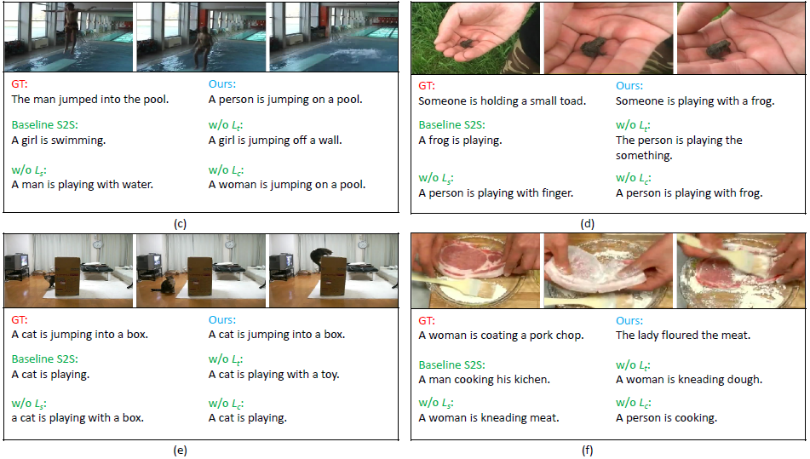
Results
Qualitative analysis
Notes:
It is interesting to observe that our method can generate sentences with more accurate semantics and syntax for describing the videos.
我们的方法能够生成更加精确的语法和语义信息，用以描述视频。
Compared with the method w/o Ls in (c), sentences generated by our method express more precise semantic meanings via effectively
solving the word bias problem.
与左下的(c)图相比，我们生成的句子可以有效解决word bias问题。
(d) indicates that learning syntax representation of sentences using Lt is indispensable to our method.
下中的(d)图表明，利用Lt学习句法结构是必不可少的。
The effect of the constraint Lc can be observed from (e) and (f) where sentences generated by the method without Lc lacks the diversity of syntactic
Structures.
从右上和右下的两图，可以看出Lc在保证句法结构多样性方面的重要作用。

Slide 55
Our work—AAAI2020
Joint Commonsense and Relation Reasoning for Image and Video Captioning
Jingyi Hou¹, Xinxiao Wu¹, Xiaoxun Zhang², Yayun Qi¹, Yunde Jia¹ ,Jiebo Luo³
¹Beijing Lab. of Intelligent Information Technology, Beijing Institute of Technology
²Alibaba Group
³Department of Computer Science, University of Rochester

Slide 56
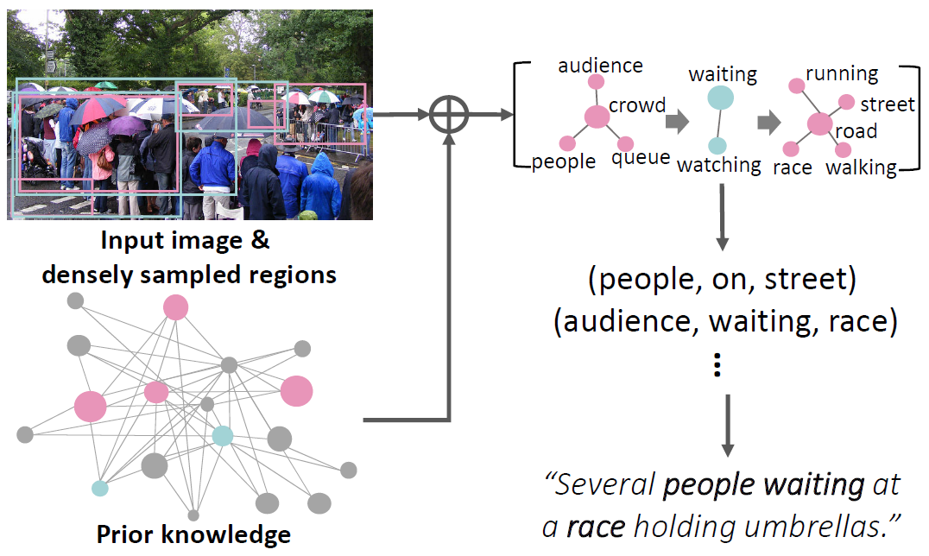
Motivation
Human beings can describe images and videos by summarizing object relationships when some objects are not precisely identified or even absent, thanks to their remarkable reasoning ability based on prior knowledge.
Leverage external prior knowledge for visual captioning

Slide 57
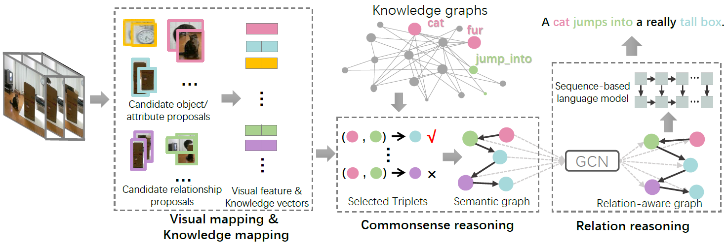
Overview

Slide 58
Method
Advantages
does not rely on any pre-trained detectors
does not require any annotations of semantic graph for training
Problems in Existing Methods
Perfromance drop
Semantic inconsistency
Our method
Leveraging external knowledge
End-to-end Learning
Commonsense
Reasoning
Relational
Reasoning
Notes:
本方法不依赖任何预训练的检测器，并且在训练时不需要语义图的标注。
这样的好处是：通过额外知识的引导来探索获得难以从视觉线索中学到的物体或关系；通过端到端的学习，可以保持图像和文字描述的语义一致性。

Slide 59
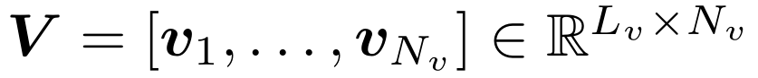
Method
Visual &. knowledge mapping
Visual mapping
objects
densely sampled video regions
Video
attributes
relationships
union arears of two sampled regions
clustering
Notes:
稠密采样视频的局部区域，将这些区域根据表观特征聚类得到候选语义（物体、属性、关系）。

Slide 60
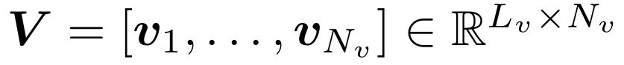
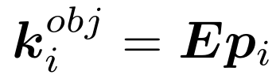
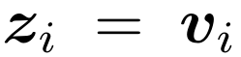
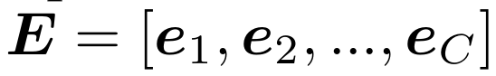
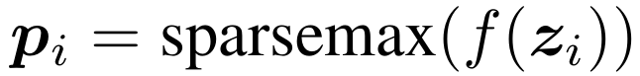
Method
Visual &. knowledge mapping
Knowledge mapping
Visual Feature Vectors
knowledge Vectors
Training:
Sparse soft-attention
binary cross entropy loss
Knowledge Embedding Vectors
Inference:
Notes:
使用视觉与知识映射学习候选语义的视觉特征向量和知识向量。

Slide 61
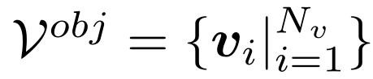
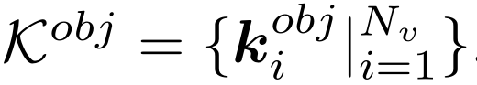
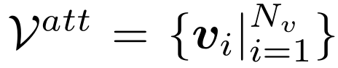
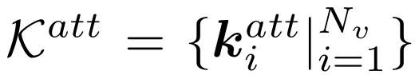
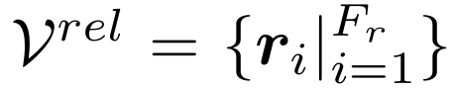
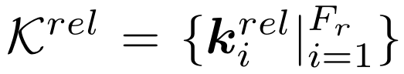
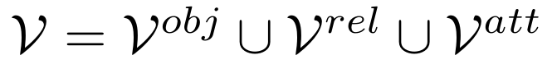
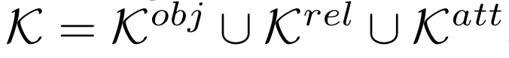
Method
Visual &. knowledge mapping
Knowledge mapping
Visual Feature Vectors
knowledge Vectors
Objects：
Visual Feature Vectors
knowledge Vectors
Attributes：
Visual Feature Vectors
knowledge Vectors
Relationships：
Final：
Visual Feature Vectors
knowledge Vectors
Notes:
Relationships和attributes的非线性网络训练方法与object的类似，
只是ground-truth标签不同，以及relationship网络的输入不同。

Slide 62
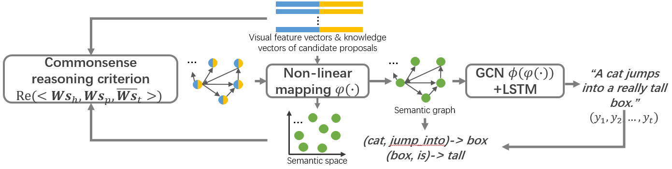
Method
Joint reasoning for visual captioning
Commonsense reasoning &. Relational reasoning
Notes:
“非线性映射模块”通过commonsense reasoning来学得，”GCN+LSTM”的作用是relational reasoning，这两个模块使用端到端的方式来联合学习。
给定proposal的特征，“Commonsense reasoning criterion” 对graph的语义特征进行选择，graph是由“non-linear mapping” 学得的。

Slide 63
Method
Joint reasoning for visual captioning
Objective function
Notes:
beta是可调超参数，L_s学习语义特征的常识推理，L_c是交叉熵损失，用于句子生成

Slide 64
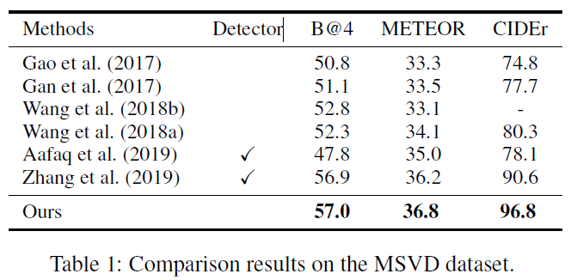
Results
Comparison with the state-of-the-art methods
Notes:
所有比较方法[10, 4, 33, 35, 16] 使用explicit high-level semantic concepts (e.g., objects, relationships) for image captioning。
[10]使用multi-label classifier生成显示语义概念，没有利用关系，比较结果表明联合推理有益于学习语义关系。

Slide 65
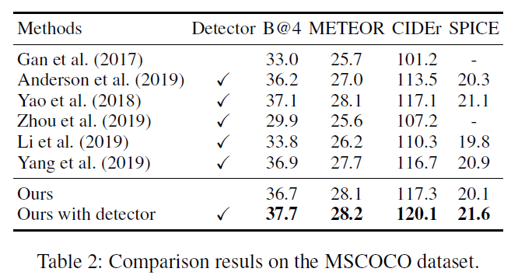
Results
Comparison with the state-of-the-art methods
Notes:
所有比较方法[10, 4, 33, 35, 16] 使用explicit high-level semantic concepts (e.g., objects, relationships) for image captioning。
[10]使用multi-label classifier生成显示语义概念，没有利用关系，比较结果表明联合推理有益于学习语义关系。

Slide 66
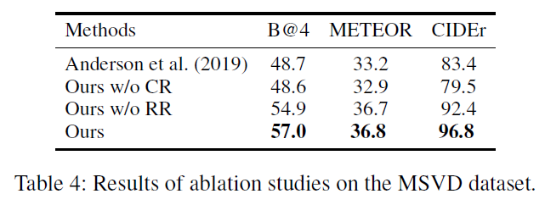
Results
Ablation Study
The effect of joint reasoning
The effect of commonsense reasoning
The effect of relational reasoning
Notes:
分别与[4]、“Ours w/o CR” 、“Ours w/o RR”比较

Slide 67
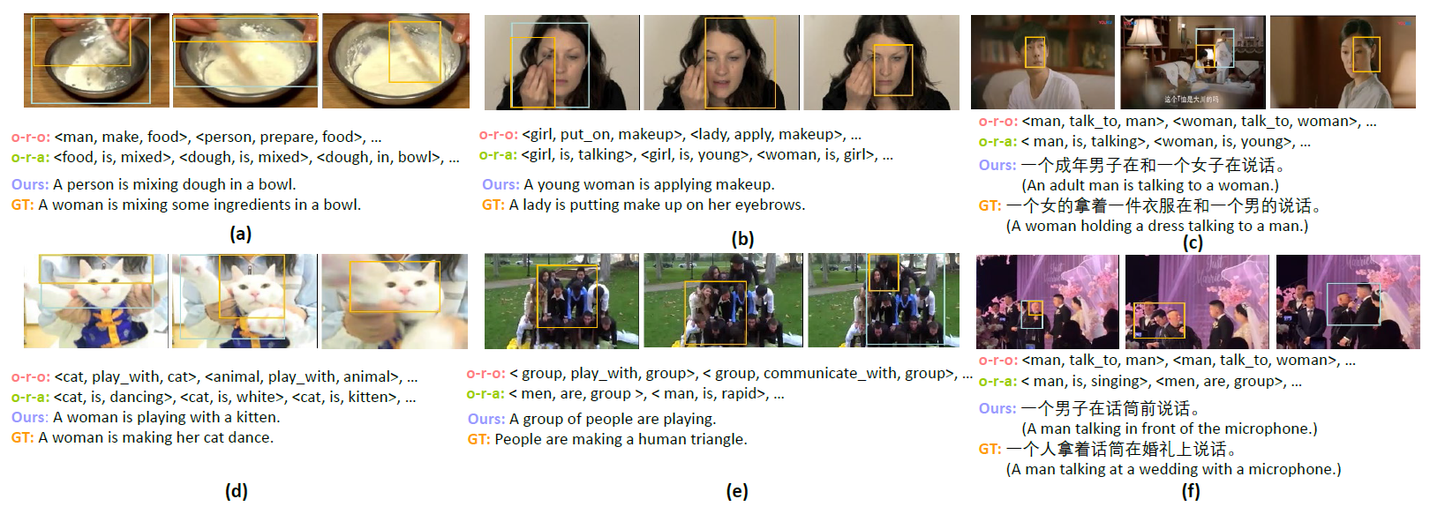
Results

Slide 68
Our work—AAAI2020
MemCap: Memorizing Style Knowledge for Image Captioning
Wentian Zhao¹, Xinxiao Wu¹, Xiaoxun Zhang²
¹Beijing Lab. of Intelligent Information Technology, Beijing Institute of Technology
²Alibaba Group

Slide 69

Introduction
Image Captioning:
generating accurate descriptions for images, ignoring linguistic style
Stylized Image Captioning:
requires integrating image content and style-related information effectively

Slide 70
Motivation
Difficulty in stylized image captioning:
style-related information is not available in the input images
large-scale dataset with images and stylized descriptions is difficult to obtain
Solution:
memorize the knowledge about linguistic styles
use scene graph as the intermediate form between images and sentences to enable training with unpaired stylized corpus

Slide 71

Overview
5 components: sentence decomposer P , style memory module M , image scene graph generator E, sentence scene graph generator F, stylized captioner C

Slide 72

Overview
Training:
decompose stylized sentence: $W_{c}, W_{s}=P(y^{s})$
extract scene graph: $G^{y}=F(W_{c})$
update M with $W_{s}$; optimize stylized captioner : ${\hat{y}}^{s}=C(G^{y}, M\left(G^{y}\right))$
Inference:
extract scene graph: $G^{x}=E(x)$
extract style knowledge: $m=M(G^{x}$)
generate stylized sentence: ${\hat{y}}^{s}=C(G^{x},m)$

Slide 73


Results
Table 1: Results of single-style image captioning
Table 2: Results of multi-style image captioning

Slide 74
Our work
Learning Multiple Cooperative Agents for Stylized Image Captioning
Wentian Zhao, Xinxiao Wu

Slide 75
Motivation
It is difficult for one-pass decoding process to effectively capture the syntactic structure, infer the semantic concept and express the linguistic styles
psychology research¹ reveals that humans compose a sentence by first constructing a coarse pattern and then filling in details, rather than directly organizing a word sequence from scratch.
we generate stylized sentences in a multi-pass decoding process by learning multiple cooperative agents under a reinforcement learning paradigm
1. L Robert Slevc. Saying what’s on your mind: Working memory effects on sentence production. Journal of experimental psychology: Learning, memory, and cognition, 37(6):1503, 2011.

Slide 76
Overview

Slide 77

Framework
Local reward— each agent focuses on its own target
Communication—attend the global information learned by the previous agent

Slide 78

Results

Slide 79

Results

Slide 80
Our work
Video Captioning using Weak Annotation
Jingyi Hou, Yayun Qi, Xinxiao Wu, Yunde Jia
Beijing Lab. of Intelligent Information Technology, Beijing Institute of Technology
Alibaba Group

Slide 81

Motivation
It is difficult to manually annotate massive videos with high-quality sentences
There exist an amazing number of videos with weak annotations
i.e., semantic concept annotations represented by noun or verb phrases
(object classification datasets dataset and action recognition datasets)
we make the first attempt to train the video captioning model with weak annotations

Slide 82
Overview
Two problems:
how to infer more abundant semantic concepts and their relations from a given semantic concept
how to generate pseudo sentences using the inferred semantic concepts and their relationships for training
we propose a progressive visual reasoning method that progressively generates fine sentences from weak annotations by inferring more semantic concepts and their dependency relationships for video captioning.

Slide 83

Framework
During each iteration,
the dependency tree is spanned via a link prediction model learned from the external knowledge, and the pseudo sentence is generated.
the captioning model is fine-tuned using the generated pseudo sentences to generate new candidate nodes for refining the dependency trees in return.

Slide 84

Results

Slide 85


Results

Slide 86

Results

Slide 87

Results

Slide 88
Our work
Cross-domain Image Captioning via Cross-modal
Retrieval and Model Adaptation
Wentian Zhao, Xinxiao Wu, Jiebo Luo

Slide 89

Introduction
Cross-domain image captioning: transfer the image captioning model trained on source domain (with paired images and sentences) to a target domain (with unpaired images and sentences)

Slide 90
Motivation
Difficulties in cross-domain image captioning:
Domain gap between source and target domain
The image-sentence pairs are not available in the target domain
We propose a novel cross-domain image captioning approach that couples an adaptive image captioning model with a cross-modal retrieval model.

Slide 91

Framework
The cross-modal retrieval model generates and iteratively refines the pseudo image-sentence pairs in the target domain to guide the model adaptation process
The adaptive LSTM transfers the language patterns learned in the source domain to the target domain

Slide 92

Results
Table 1. Quantitative evaluation results of cross-domain image captioning on different target domains.

Slide 93


Results
Table 2. Quantitative evaluation results of cross-domain video captioning on different target domains.

Slide 94
Language-driven Action Localization

Slide 95
What is language-driven action localization
localization of one target video segment which semantically corresponds to a given language query.
Two components:
Understanding the video and the language query.
Cross-modal Matching of video segments and the language query.

Slide 96

Language-driven action localization
Some examples of localization

Slide 97

Two-stage Localization Method: basic idea
(a) Generating action proposals by sliding window method or proposal generator.
(b) Modeling temporal context information of proposals.
(c) Predicting regression parameters and cross-modal matching.

Slide 98

One-stage Localization Method: basic idea
Understanding the video and the query.
Modeling temporal context information.
Prediction of matching score, regression offset, probability of boundary.

Slide 99
Two-stage Localization method
Sliding window based method
Generating proposals by multi-scale sliding windows.
Cross-modal matching.
Squared Distance
Hendricks et al., Localizing moments in video with natural language, ICCV, 2017.
Cross-modal fusion + prediction head
Gao et al., Tall: Temporal activity localization via language query, ICCV, 2017.
Attention-based cross-model fusion
Liu et al., Attentive moment retrieval in videos, CSIGIR, 2018.
Early fusion retrieval method
Xu et al., Multilevel language and vision integration for text-to-clip retrieval, AAAI, 2019.
Notes:
二阶段定位方法可以分为滑动窗口类方法和proposal生成器类方法。
本页ppt介绍了二阶段定位方法中的滑动窗口类方法：这类方法先使用多级滑动窗口生成proposal，然后使用跨模态匹配方法进行句子和视频段的匹配，创新点在于跨模态匹配。
下面又贴了这类定位方法中常见的跨模态匹配方法：
1.使用视频和句子的全局特征在共同嵌入空间中的平方距离作为匹配的评价标准，特征距离越小，匹配分数越高；
2.将视频和句子的特征进行跨模态融合，然后使用额外的预测网络预测匹配分数；
3.将视频和句子使用注意力机制进行跨模态融合，然后使用额外的预测网络预测匹配分数；
4.将视频和句子使用基于LSTM的早期融合（late fusion晚期融合是指分别得到视频和句子在共同嵌入空间的特征，然后计算相似分数，early fusion早期融合是计算相似分数前就融合视频和句子特征，然后使用融合的特征计算相似分数）方法进行跨模态融合，然后使用额外的预测网络预测匹配分数。

Slide 100

Cross-modal matching method
Attention-based cross-model fusion
(a) Cross-modal interaction of video and query
(b) Computing attention sequence and attended query feature
(c) Cross-modal fusion
(a)
(c)
(b)

Slide 101
Two-stage Localization method
Proposal generator based method
Generating proposals by proposal generator.
Query-guided proposal network
Xu et al., Multilevel language and vision integration for text-to-clip retrieval, AAAI, 2019.
Semantic score sequence based proposal generator
Chen et al., Semantic proposal for activity localization in videos via sentence query, AAAI, 2019.
Cross-modal matching.
Notes:
基于proposal生成器的二阶段定位方法：这类方法先使用proposal生成器生成proposal，然后进行跨模态融合，这类方法的创新点在proposal生成器上面。
第一种proposal生成器将句子特征与视频特征序列进行融合，然后使用该融合特征在每个视频段上预测以该视频段为中心的动作边界和动作分数，经过非极大抑制后处理，生成proposal。
第二种proposal生成器为视频每一帧生成一个分数，这个分数表示句子中所有语义在该帧中出现的多少。一个视频可以得到一个分数序列，这类方法通过在分数序列上划阈值，生成proposal。

Slide 102

Query-guided proposal network
(a)Cross-modal interaction of video and query
(b)Computing temporal attention weights
(c)Computing weighted video 3D feature sequence
(d)Computing anchor feature by ROI pooling
(e)Computing regression parameters
(a)
(b)
(c)
(d)
(e)

Slide 103

One-stage localization method
Anchor-based method
Only matching scores
Chen et al., Temporally grounding natural sentence in video, EMNLP, 2018.
Matching scores and regression parameters
Yuan et al., Semantic conditioned dynamic modulation for temporal sentence grounding in videos, NIPS, 2019.
Notes:
基于anchor的定位方法可以分为两类：
第一类方法设置固定的anchor，模型只预测anchor内的视频片段与句子的匹配分数，不预测anchor边界的回归系数。
第二类方法既预测anchor内视频片段与句子的匹配分数，也预测anchor边界的回归系数。

Slide 104

One-stage localization method
Boundary prediction method
Predicting boundary directly
Yuan et al., To find where you talk: Temporal sentence localization in video with attention based location regression, AAAI, 2019.
Mun et al., Local-Global Video-Text Interactions for Temporal Grounding, CVPR, 2020.

Slide 105

Boundary prediction method: Attention Based Location Regression
(a) contextual incorporated feature encoding
(b) Multi-modal Co-attention interaction
(c) Attention Based Coordinated Prediction
Notes:
本页ppt介绍的方法是一阶段方法中根据注意力序列直接预测边界的方法：
这类方法首先将视频和句子编码为特征序列，然后进行视频和句子的跨模态交互，生成一个注意力序列，
这个注意力序列表示每一帧或每一段对整个句子的注意力程度，
最后这类方法以该注意力序列为（全连层的）输入，直接预测动作的边界。

Slide 106

One-stage localization method
Boundary prediction method
Predicting boundary regression parameters.
Chen et al., Localizing natural language in videos, AAAI, 2019.
Ghosh et al., Excl: Extractive clip localization using natural language descriptions, NACCL, 2019.

Slide 107

Boundary prediction method: Extractive Clip Localization
(a)Query encoding
(b)video encoding
(c)cross-modal fusion and predicting probabilities of boundaries
(c)
(b)
(a)
Notes:
本页ppt介绍的是一阶段方法中直接预测边界概率的方法：
这类方法首先对视频特征序列和句子特征序列进行跨模态的融合，得到一个融合之后的特征序列
然后直接预测每个特征代表的时序位置是动作开始的概率和动作结束的概率，
最后通过两个概率序列直接选出动作的边界。（即动作开始概率序列中选动作开始的位置，动作结束概率序列中选动作结束的位置，同时要保证开始位置在结束位置之前）

